Slide 2


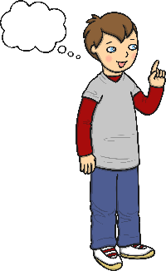
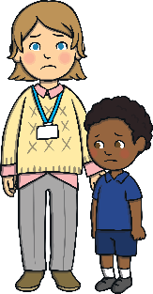
Telling the Truth
Sometimes I tell lies.
A lie is something that did not happen.
It makes my friends and teachers sad when I tell a lie. It can hurt their feelings.

Slide 3

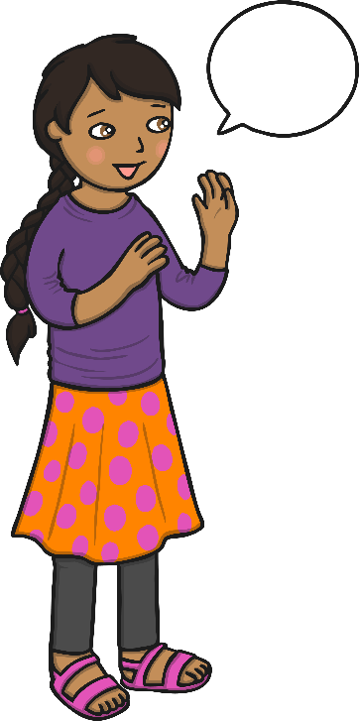
What Should I Do?
Remember to
tell the truth.
Say the first
thing that I think of.

Slide 4
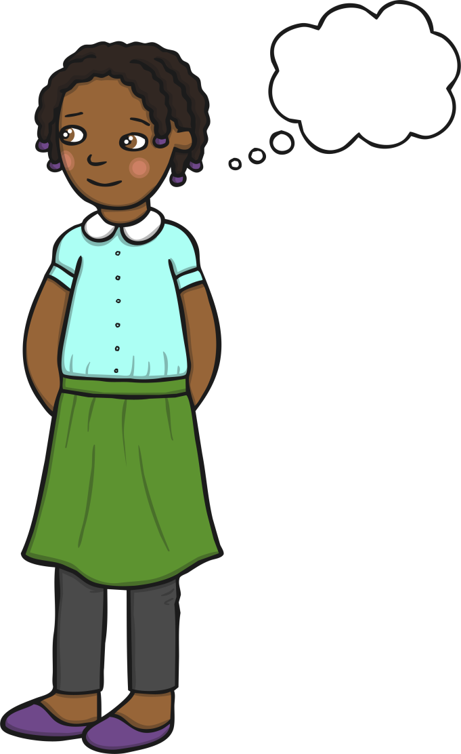
Well Done! Great Choice!
I can try to tell the truth.
I can:
stop for a minute;
think about what I am going to say;
decide: It is true?
My teacher can help me with this.
This will make my friends and teachers happy.

Slide 5
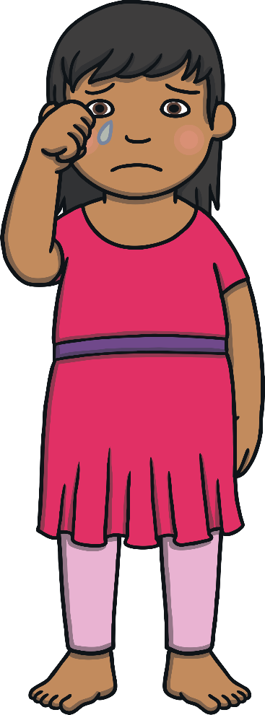
Hmmm... Let’s Think About What Happens If I Tell Lies
If I tell lies, I can annoy and upset people.
This might make my teachers or friends
feel sad.
I might get in trouble.
How would you feel if your friend
told a lie about you?

Slide 6

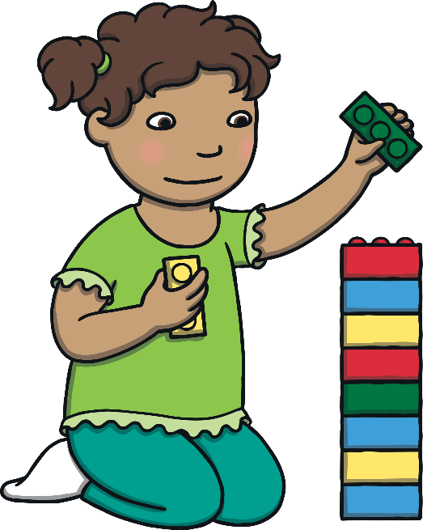
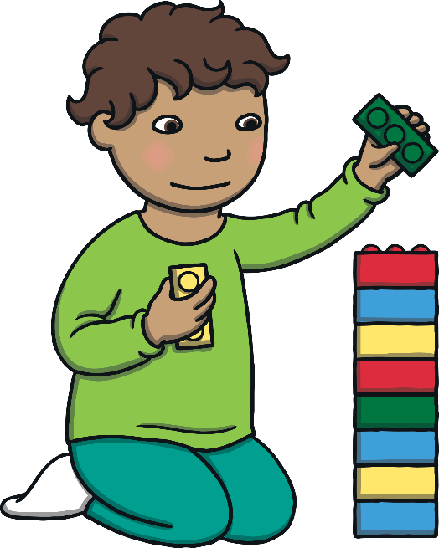
Telling the Truth
I will try to remember to tell the truth.
I will try to stop and think about what to say before
I speak.
My teacher will help me
with this.
My friends will feel happy and
we can all play together.

